Slide 1
Git 101
By Dima Gonikman

Slide 2
Agenda
Get to know git & its’ principals
Commits and Branches
Commands
Daily work

Slide 3
What is Git?
Git is a term of insult with origins in English denoting an unpleasant, silly, incompetent, annoying, senile, elderly or childish person

Slide 4
What is Git?
A version control system
Used to track code changes made by a development team

Slide 5
Git principles
Each developer has its’ own local copy of the repository and entire history
Work can be tracked offline – without any connection to the server
Synchronization with server is done locally

Slide 6
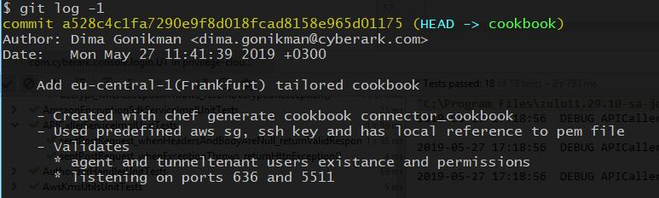
Commit
Commit Hash
Description (message)
Changed files
Parent Hash
Author, Date

Slide 7
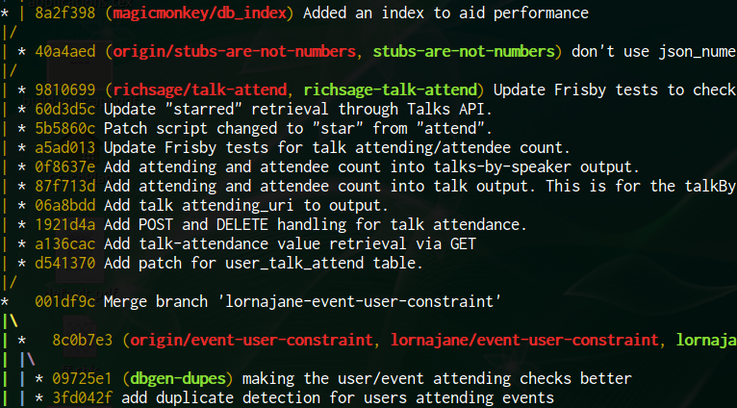
Branch
A placeholder in git, used to mark work topic
Tracks the last commit made to the specified branch
Similar to TFS branch, a lightweight version of it

Slide 8
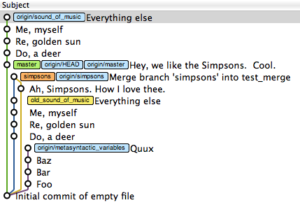
Graph representation

Slide 9
Commands #1
Init/Clone – Initialize local folder
Checkout – crate new branch in a specific location
Status – Show current local state of the repository
Add – Include files in commit
Commit – Create a commit
Fetch/Pull – Get changes from the server
Push – Publish changes to the server
Notes:
reset; git clone; git fakeTeamwork 2; delay 3000; git commit; git commit;

Slide 10
Commands #1
Let’s try it out!

Slide 11
Commands #2
Reset
Mixed – Modify commits, no change in files
Hard – Delete commit and changed files
Revert – Undo a commit, creates an opposite commit
Cherry pick – take a commit as-is and apply it in the current state
Merge – Combine all work from another branch into the current
Rebase – Place all work of the current branch on top of another
Notes:
reset; git clone; git fakeTeamwork 2; delay 3000; git commit; git commit; delay 3000; git fetch; clear;

Slide 12
Commands #2
Let’s try it out!

Slide 13
Daily Work
File lifecycle
Git Extensions
Pull requests
Git vs TFS

Slide 14
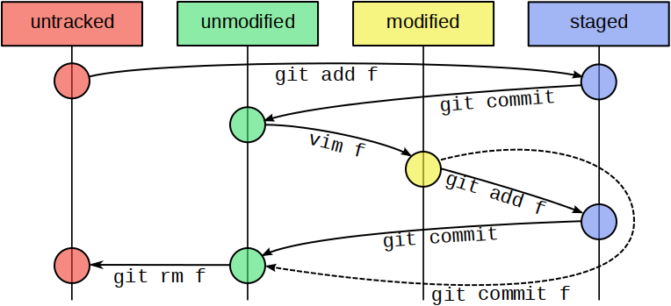
File lifecycle

Slide 15
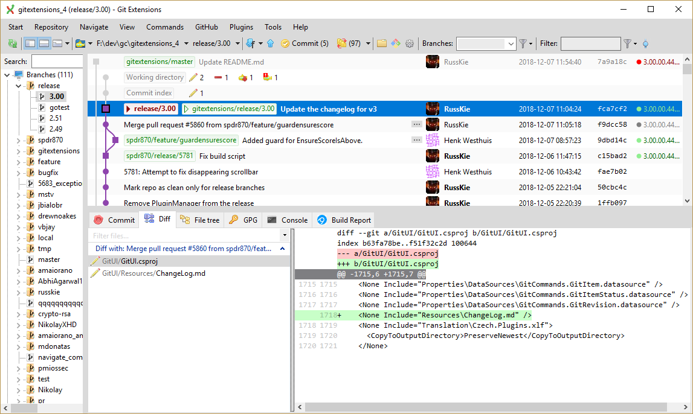
Git Extensions

Slide 16
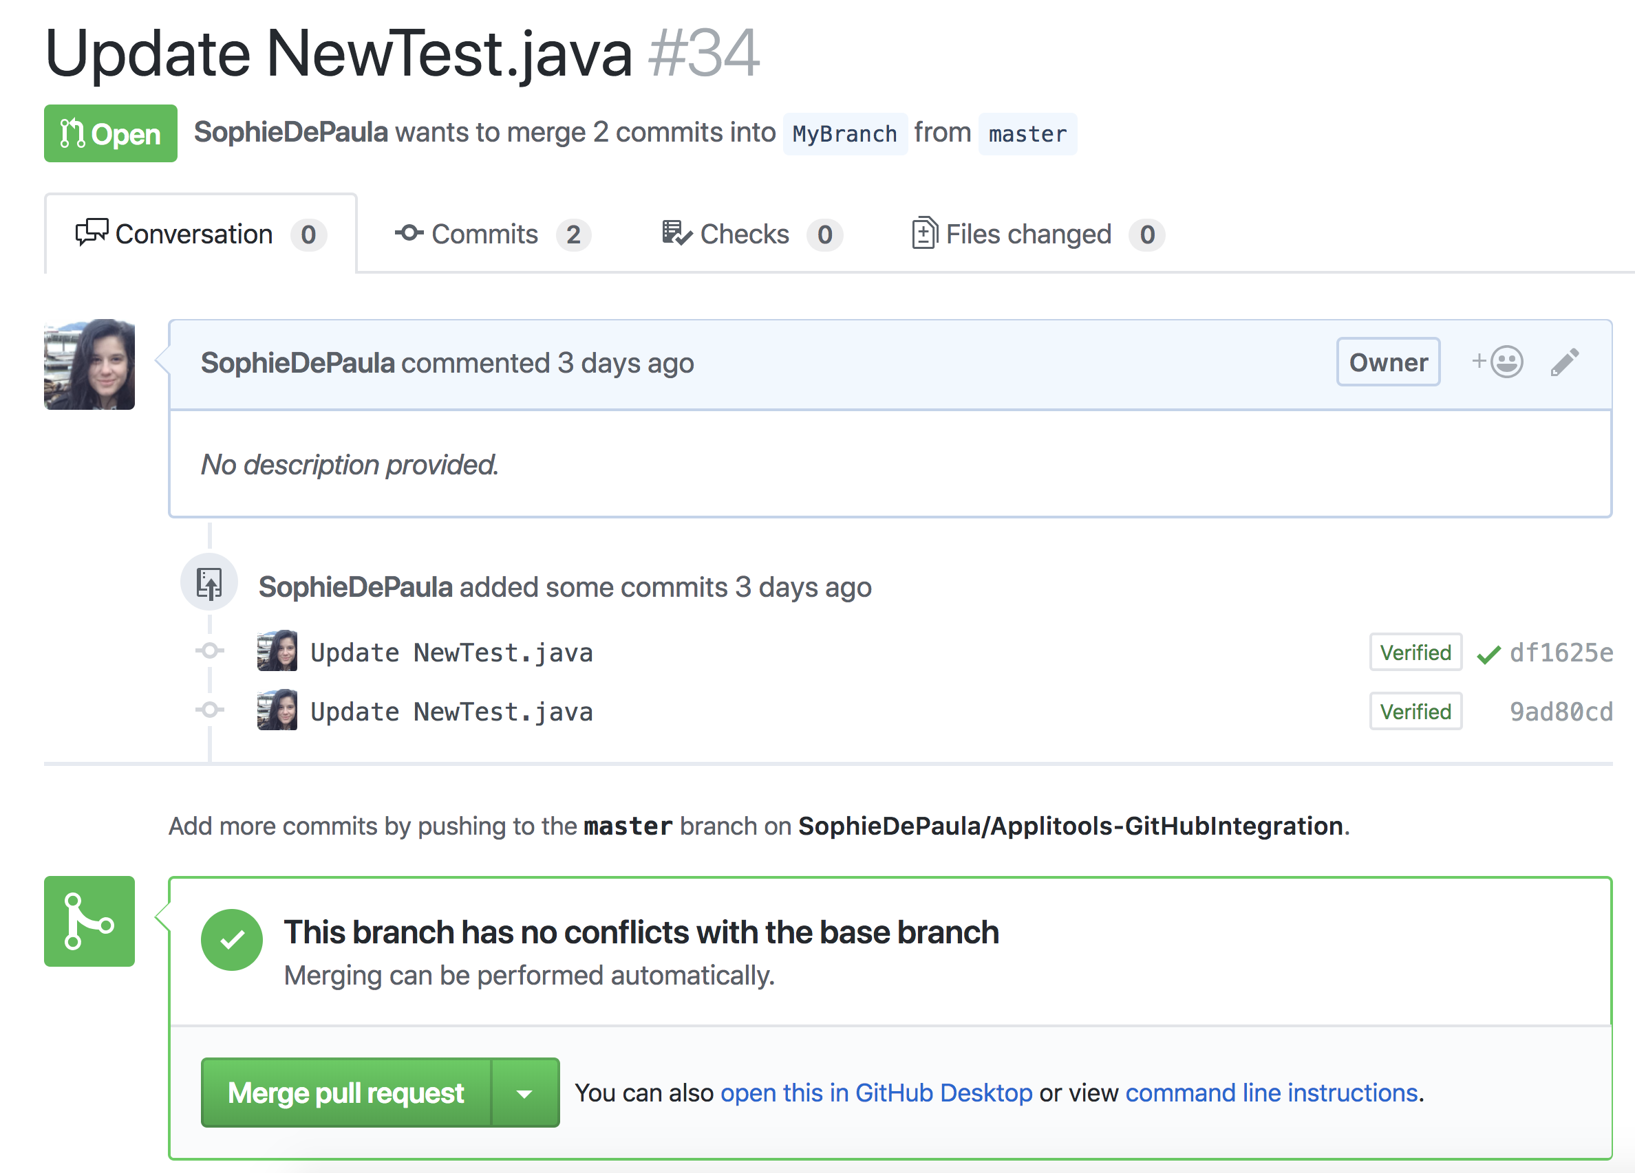
Pull requests

Slide 17
Git vs TFS
TFS | Git
Check in | Commit + Push | Changeset
File | Line | Change granularity
Get latest | Fetch / Pull | Sync repo
Online work | Offline work | Connectivity
Checkout for edit | None | Locking
Full clone | A mark on a commit | Branching

Slide 18


